Slide 1
Chemistry 120
Chapter 4: Introduction to Gases
Chapter 14: The Ideal Gas Law and It’s Applications

Slide 2
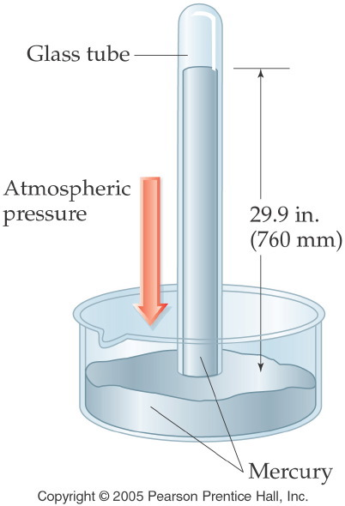
Notes:
Figure: 11-03
Title:
Torricelli's Mercury Barometer
Caption:
A sealed glass tube is filled with Hg and inverted. The air pressure can support a 760 mm column of Hg.
Notes:
The barometers in use today still rely on the same general instrumentation. Units of mmHg and torr were derived directly from this experiment. Mercury barometers are used less frequently than in the past due to the toxicity of mercury vapor.

Slide 3
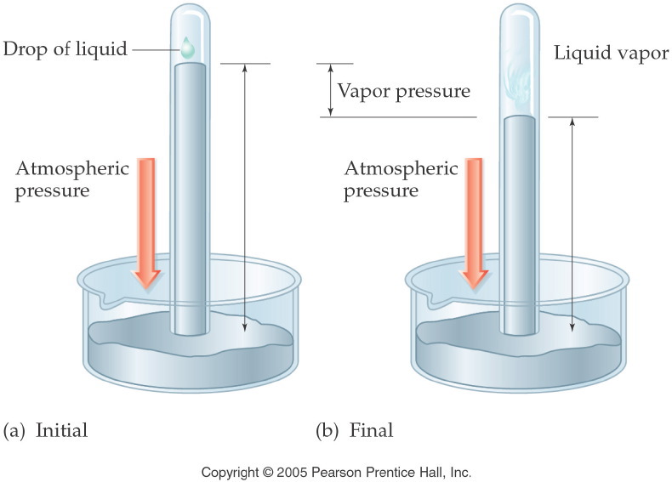
Notes:
Figure: 11-10
Title:
Measuring Vapor Pressure
Caption:
A single drop of liquid is placed onto the top of a barometer. Eventually, the pressure can be measured.
Notes:
Vapor pressure is temperature-dependent. A liquid will evaporate to a greater extent at increased temperature, increasing vapor pressure.

Slide 4
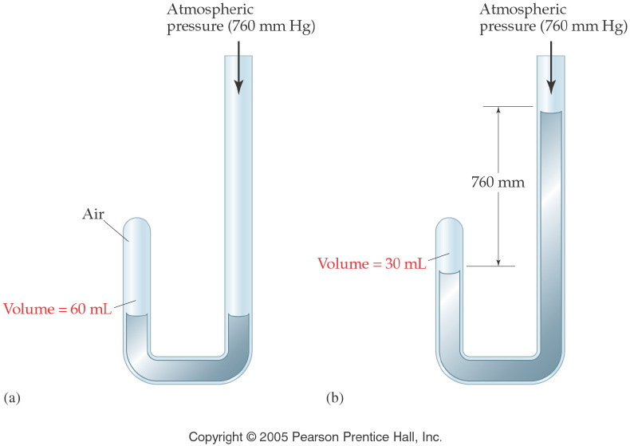
Notes:
Figure: 11-05
Title:
Boyle's Law
Caption:
The volume of a gas is halved when the pressure is doubled. The inverse is also true.
Notes:
Volume and pressure are inversely proportional.

Slide 5
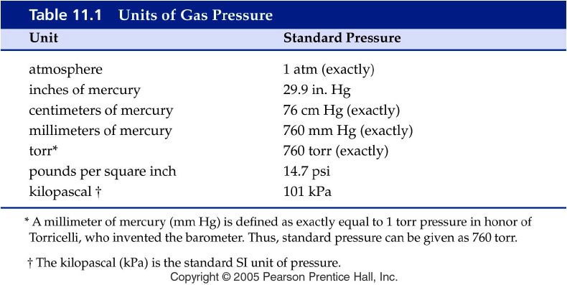
Notes:
Figure: 11-T01
Title:
Table 11.1
Caption:
Units of Gas Pressure
Notes:
Various units of gas pressure are shown. You can convert from one unit to another by using the appropriate unit factor that will cancel the given unit.

Slide 6
Example – Gas Conversions
Convert 15.1 psi to cm Hg. Use standard notation and three significant figures.

Slide 7
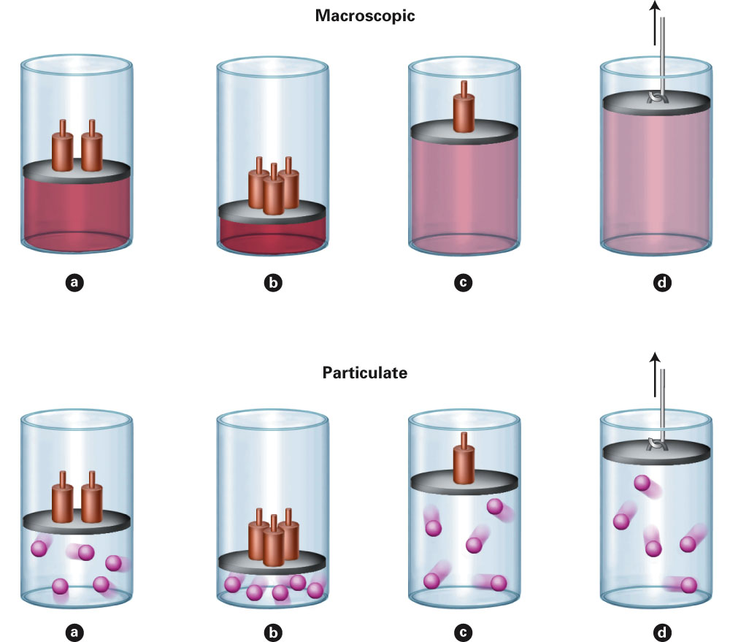
Fig. 4-1, p. 100

Slide 8
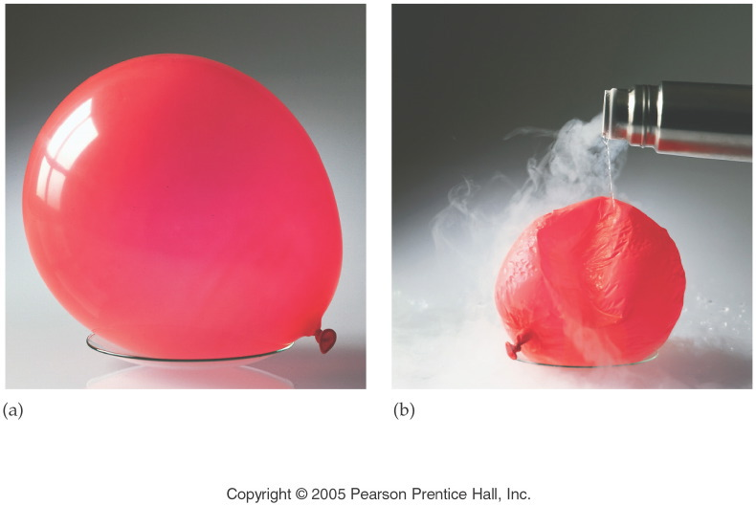
Notes:
Figure: 11-07-01UN
Title:
Illustration of Charles' Law
Caption:
(a) A balloon contains air at room temperature. (b) As liquid nitrogen at -196°C is poured on the balloon, the air inside the balloon cools, causing it to decrease in volume.
Notes:
Charles' Law: as the temperature of the gas decreases, its volume decreases. Temperature and volume are directly proportional.

Slide 9
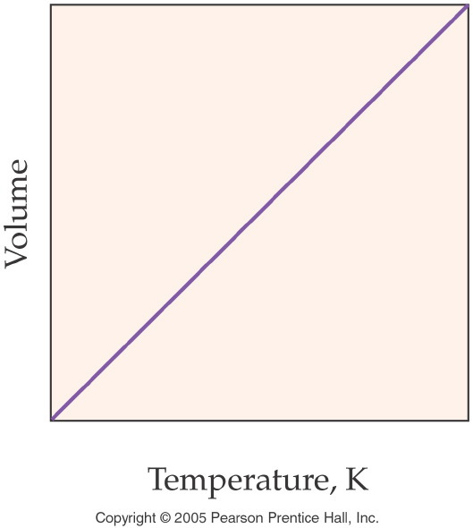
Notes:
Figure: 11-07
Title:
Gas Volume vs. Temperature
Caption:
As the temperature decreases, the volume of a gas decreases. V and T are directly proportional.
Notes:
This graph represents the volume and temperature of a gas at a constant pressure, throughout a large range of values.

Slide 10
Example – Charles’ Law
A 407 mL sample of oxygen at 25 °C is heated to 55 °C, what is the new volume? Assume the pressure and number of moles is constant.

Slide 11
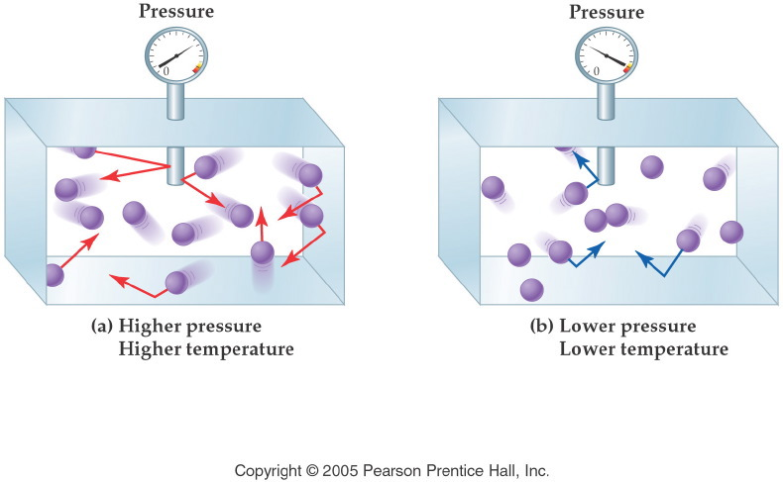
Notes:
Figure: 11-01
Title:
Pressure and Frequency/Energy
Caption:
Molecules that move faster collide with more energy. Slower molecules collide with less energy.
Notes:
Gas pressure is a function of energy, and energy is a function of velocity and mass. Mass is fixed, but velocity can be increased by increasing the temperature of the gas.

Slide 12
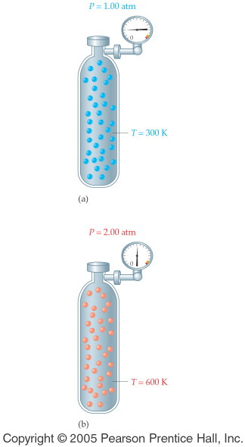
Notes:
Figure: 11-08-01
Title:
Gay-Lussac's Law
Caption:
A cylinder contains He gas at 300K and 1.00 atm. As the temperature is doubled to 600K, the pressure doubles to 2.00 atm.
Notes:
Pressure and temperature are directly proportional. As T increases, P increases.

Slide 13
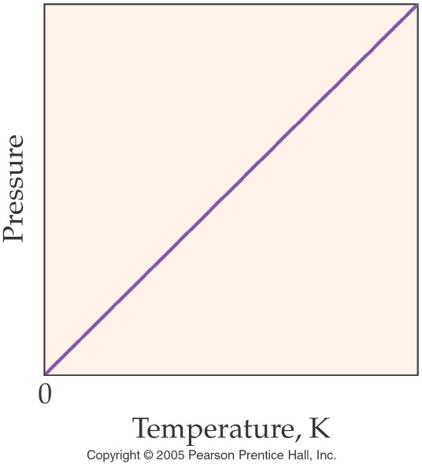
Notes:
Figure: 11-08
Title:
Gas Pressure vs. Temperature
Caption:
As the temperature decreases, the pressure of a gas decreases. P and T are directly proportional.
Notes:
This graph represents the pressure and temperature of a gas at a constant volume, throughout a large range of values.

Slide 14
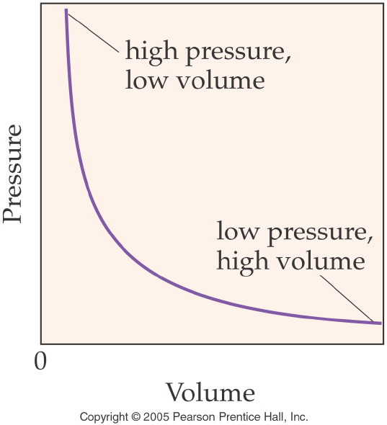
Notes:
Figure: 11-06
Title:
Gas Pressure vs. Volume
Caption:
As the volume of a gas increases, the pressure decreases. V and P are inversely proportional.
Notes:
This graph represents the volume and pressure of a gas at constant temperature, throughout a large range of values.

Slide 15
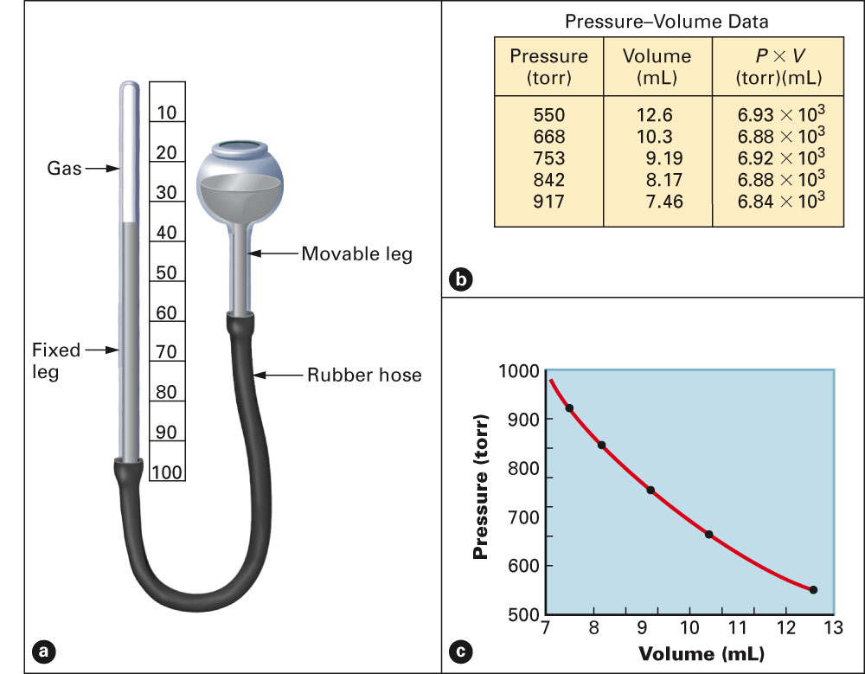
Fig. 4-14, p. 112

Slide 16
Example – Boyle’s Law
A sample of air at 0.750 atm is expanded from 250.0 mL to 655.0 mL at constant temperature and number of moles, what is the new pressure?

Slide 17
Example – Combined Gas Law
A sample of krypton gas has a volume of 250.0 mL at 225 mm Hg and -125 °C. Calculate the pressure in kPa, if the gas is heated to 100 °C and now occupies 200.0 mL. Assume constant number of moles.

Slide 18
Example – Avogadro’s Law
A balloon with a volume of 220. mL is filled with 2.0 moles of helium. To what volume will the balloon expand if 3.0 moles of helium is added? Assume that the pressure and temperature is constant.

Slide 19
Example – Ideal Gas Law
Butane, C₄H₁₀, is used as a fuel for barbecues and as an aerosol propellant. If you have 108 mL of butane at 0.952 bar and 25.0 °C, how many moles of butane is in the cylinder?

Slide 20
Example – Ideal Gas Law
What is the volume of 1.20 g of carbon monoxide at 8.0 °C, if it has a partial pressure of 724 mmHg?

Slide 21
Example – Applications of the Ideal Gas Law
What is the molar mass of a gas, if a 3.16 g sample of gas at 0.750 atm and 45.7 °C occupies a volume of 2.05 L?

Slide 22
Example – Applications of the Ideal Gas Law
A gaseous compound has an empirical formula of CH₂. When the gas is at 23 °C and 0.990 atm it has a volume of 0.783 L and a mass of 2.23 g. What is the molecular formula of the gas?
CH₂
C₂H₄
C₃H₆
C₄H₈
C₅H₁₀

Slide 23
Example – Applications of the Ideal Gas Law
What is the density of xenon gas, if a 1.72 g sample is at 54 °C and 1.10 atm?

Slide 24
Example – Applications of the Ideal Gas Law
If the density of propane, C3H8, is 0.483 g/mol at 25 °C, what is the pressure of a 5.18 g sample that occupies 10.5 mL?

Slide 25
Example – Molar Volume
What is the molar volume of a gas at STP?

Slide 26
Example – Molar Volume
Calculate the molar volume of oxygen gas at 15 °C and 0.669 atm.

Slide 27
Example – Gas Stoichiometry
When potassium metal reacts with chlorine gas the product is solid potassium chloride. How many grams of potassium chloride is produced when 7.25 L of chlorine gas at STP react with excess potassium?

Slide 28
Example – Gas Stoichiometry
How many liters of hydrogen chloride gas are produced when 1.25 L of hydrogen gas react with excess chlorine gas?

Slide 29
Example – Gas Stoichiometry Limiting Reagent
Nitrogen dioxide gas reacts with water vapor to produce oxygen and ammonia gases. If 12.8 g of nitrogen dioxide reacts with 5.00 L of water vapor at 375 °C and 725 torr, how many grams of ammonia can be produced? Use an ICE table.

Slide 30
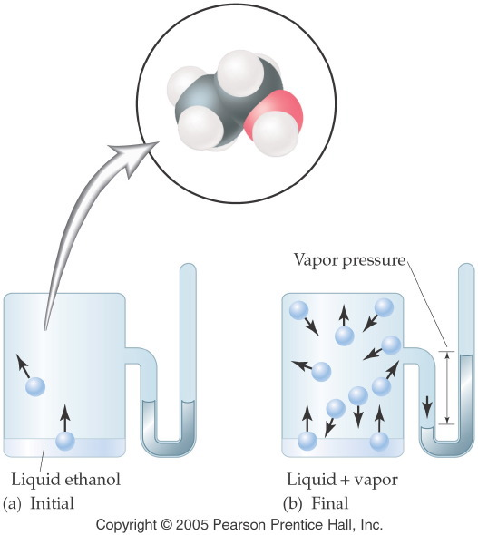
Notes:
Figure: 11-09
Title:
Vapor Pressure of a Liquid
Caption:
In a closed container, molecules of ethanol are evaporating and condensing at the same rate.
Notes:
All liquids show continual evaporation, however slight. In a closed system, the pressure of the gas evolved can be measured since the pressure is constant due to the continuouw condensation at the same rate as the evaporation.

Slide 31
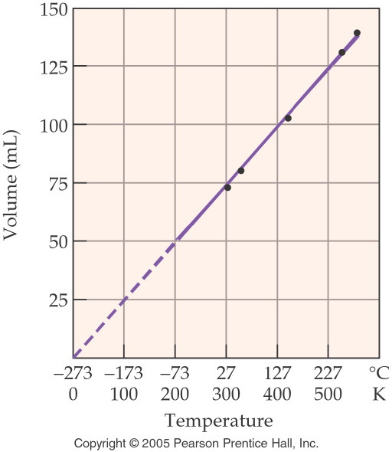
Notes:
Figure: 11-12
Title:
Absolute Zero at Zero Volume
Caption:
As the temperature approaches absolute zero, the volume of a gas decreases to zero.
Notes:
The Kelvin scale of temperature was derived from absolute zero, where temperature is 0 K. THe value of absolute zero was extrapolated from data for the volume of a gas versus temperature.

Slide 32
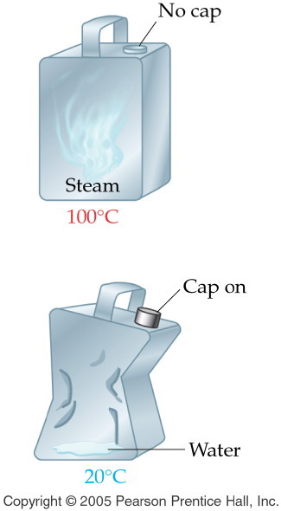
Notes:
Figure: 11-13-01KC01
Title:
A Metal Canister
Caption:
As the steam cools, the can is crushed.
Notes:
This diagram is part of Ch. 11, Key Concepts #1.

Slide 33
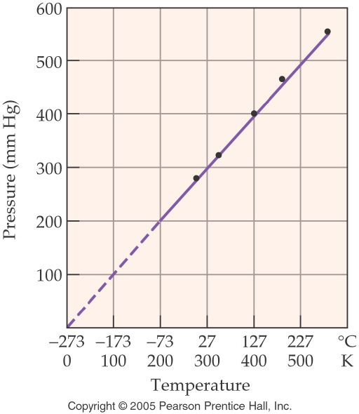
Notes:
Figure: 11-13
Title:
Absolute Zero at Zero Pressure
Caption:
As the pressure of a gas decreases to zero, the temperature approaches absolute zero.
Notes:
The Kelvin scale of temperature was derived from absolute zero, where temperature is 0 K. The actual value of absolute zero is extrapolated from the graph.

Slide 34
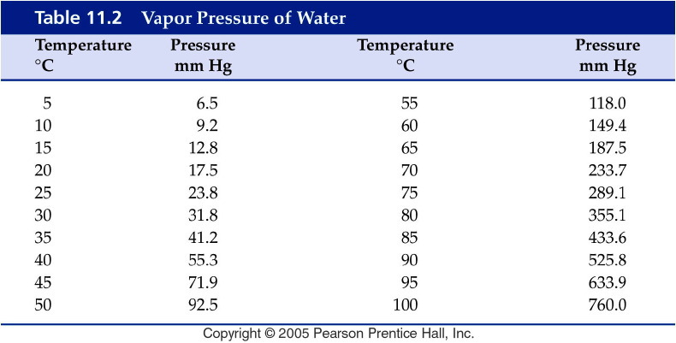
Notes:
Figure: 11-T02
Title:
Table 11.2
Caption:
Vapor Pressure of Water
Notes:
The vapor pressure of water increases with temperature because at a higher temperature, more water molecules have enough energy to become vapor.

Slide 35
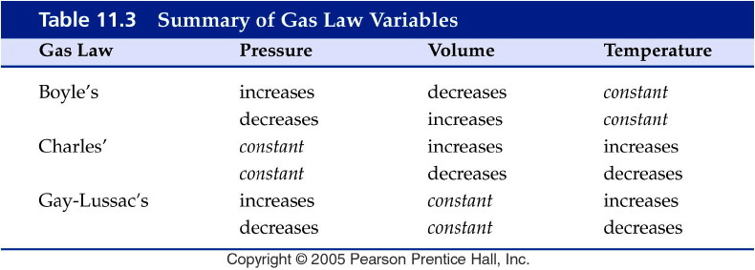
Notes:
Figure: 11-T03
Title:
Table 11.3
Caption:
Summary of Gas Law Variables
Notes:
This table summarizes the various types of problems that you can do with the combined gas law and the three specific gas laws that you can get from the combined gas law.

Slide 36
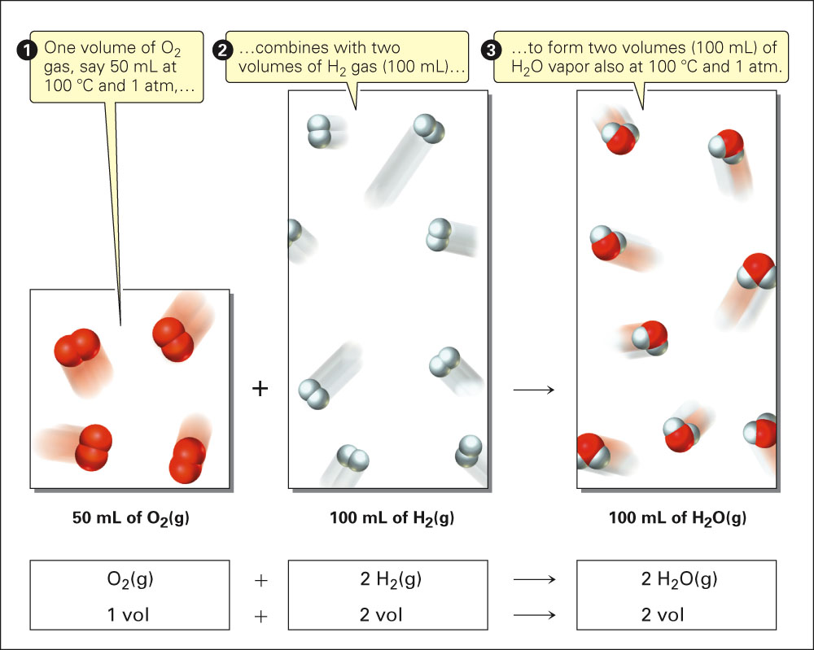
Fig. 14-1, p. 403

Slide 37
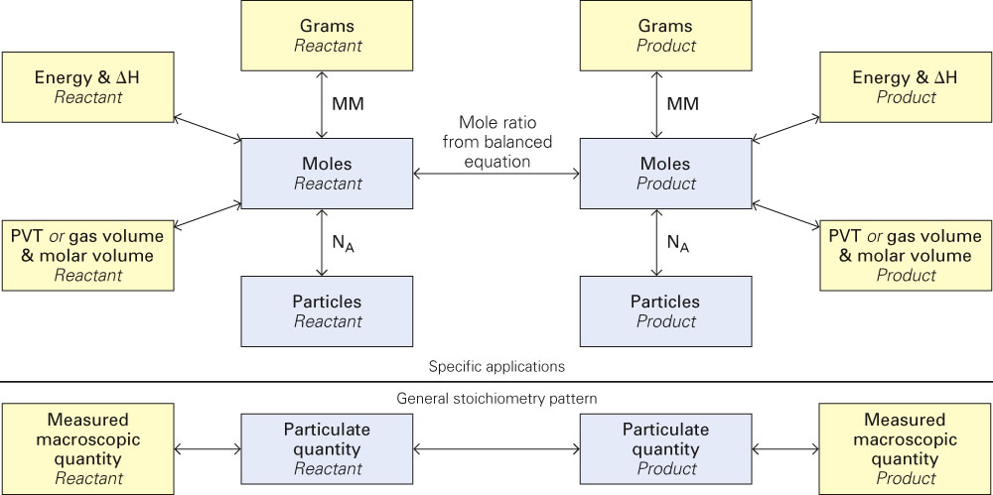
Fig. 14-6, p. 414

